Slide 1

Smart Budget
Made by Edward Pratt and Sandy Hay

Slide 2



Topics
Introduction
Analysis
Design
Code & Testing
Conclusion

Slide 3

Introduction
This is our submission attempt for this terms’ Hackathon, where we create a website where we can help monitor and assist with people’s spending budgets, and provide financial insight.

Slide 4

Analysis
THE IDEAS AND CONCEPTS FOR THE PROJECT

Slide 5
The Purpose of this Project
What is the purpose of this project?
The analysis phase for a smart budgeting system focuses on understanding user financial behaviour, identifying spending patterns, and providing actionable insights to improve money management.
This involves collecting and processing data related to income, expenses, savings, and debts while categorizing transactions to identify trends and irregularities.

Slide 6
The Purpose of this Project
What Exactly are we looking for?
This project seeks to answer critical questions for the users such as:
What are the user’s major expense categories (e.g., food, rent, subscriptions)?
Are there opportunities to reduce unnecessary spending?
Is the user consistently saving money or living paycheck to paycheck (spending most or all their income, leaving no more for savings)?
How closely does the user follow their budget plan?

Slide 7
The Purpose of this Project
Our plan for the project
We decided to use the web development environment React, where we have coded in JavaScript for the front-end of the website.
We have also used Java for the back-end of the project.

Slide 8

Design
THE DESIGN OF THE PROJECT

Slide 9
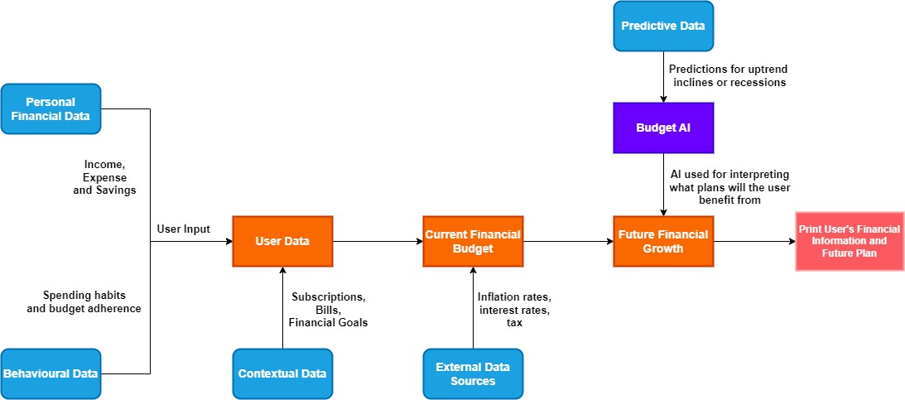
Diagram Design

Slide 10

Code & Testing
WHAT WE HAVE DONE

Slide 11
Chart

Slide 12
Table
 | Category 1 | Category 2 | Category 3 | Category 4
Item 1 | 4.5 | 2.3 | 1.7 | 5
Item 2 | 3.2 | 5.1 | 4.4 | 3
Item 3 | 2.1 | 1.7 | 2.5 | 2.8
Item 4 | 4.5 | 2.2 | 1.7 | 7

Slide 13
Content 2
Subtitle
subtitle
subtitle
Add text, images, art, and videos.
Add transitions, animations, and motion.
Save to OneDrive, to get to your presentations from your computer, tablet, or phone.
Open the Design Ideas pane for instant slide makeovers.
When we have design ideas, we’ll show them to you right there.
Add text, images, art, and videos.
Add transitions, animations, and motion.
Save to OneDrive, to get to your presentations from your computer, tablet, or phone.
Open the Design Ideas pane for instant slide makeovers.
When we have design ideas, we’ll show them to you right there.
Add text, images, art, and videos.
Add transitions, animations, and motion.
Save to OneDrive, to get to your presentations from your computer, tablet, or phone.
Open the Design Ideas pane for instant slide makeovers.
When we have design ideas, we’ll show them to you right there.

Slide 14
Summary

Slide 15
Q&A

Slide 16


Thank You

